Slide 1
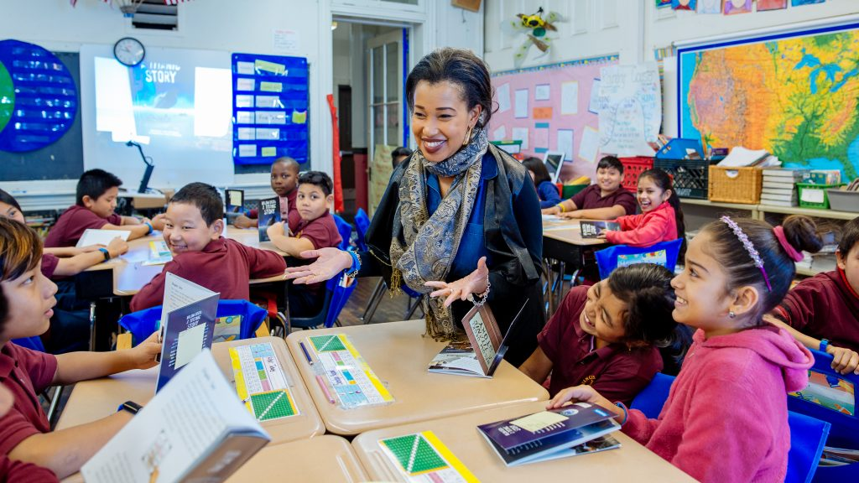

George Washington High School PLC #3:
Checking and Challenging Biases
Pathway: Foundational Equity Knowledge, Skills, and Mindsets

Slide 2

WELCOME!
As you come in, please grab a piece of paper and fold it in half “hamburger style”
Then, on one of the front sides, write down something that you are really proud of about yourself. Feel free to decorate as well!
If you are comfortable, share what you wrote with others around you!

Slide 3
As we start, on the inside of the piece of paper you just folded and wrote on, leave one of the spaces blank.
Take 1 minute to think about something about yourself that you are working to improve upon or are maybe not QUITE as proud of. You may write this down or leave the space blank and just think about it.

Slide 4
“Forgiveness and compassion are always linked: how do we hold people [and ourselves] accountable for wrongdoing and yet at the same time remain in touch with their [our] humanity enough to believe in their [our] capacity to be transformed?”
bell hooks
* Adapted to include [and ourselves] and [our]
Inclusive Welcome
What does this quote mean to you?

Slide 5
SDP Commitment to Equity
SDP Equity Definition
Equity at SDP means to: cultivate prosperity and liberation for students and staff, starting with historically marginalized populations, by removing barriers, increasing access and inclusion, building trusting relationships, and creating a shared culture of social responsibility and organizational accountability
Guardrail #1
Welcoming & Supporting Schools
Every school will be a safe, welcoming and healthy place where our student, staff, and community want to be and learn each day.
This means our schools will be: Spaces with inclusive climates that provide students with access to robust social, emotional, & mental health supports
Guardrail #4
Addressing Racist Practices
Our students’ potential will not be limited by practices that perpetuate systemic racism and hinder student achievement

Slide 6
The Journey We’re On:
Conocimiento (trusting relationships)
Checking & Challenging Bias Pt I
January
April
February
May
Identity, Power & Privilege (trusting relationships)
Checking & Challenging Bias Pt II
2024 George Washington High School Equity PLCs

Slide 7
Today’s Objectives
Critical Self Reflection
Understand and hone our awareness of implicit/unconscious bias.
Connecting to our Context
Examine how implicit bias shows up in education.

Slide 8
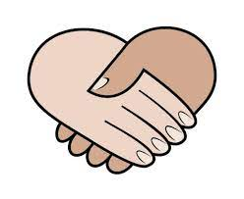
Stay engaged
Speak your truth, using “I” statements
Remain curious
Own any discomfort
Community Agreements

Slide 9
Things We Agree On:
We are ALL passionate about education
We all want the best for ALL of our students, regardless of their backgrounds and identities
We ALL have things we are GREAT at as well as areas where we can grow
Things We Agree On

Slide 10
SELF
“To reach others, we have to first know ourselves. And to contact the deeper truth of who we are, we must engage in some activity or practice that questions what we assume to be true about ourselves.”
-A.H. Almaas
COMMUNITY
“Community isn’t always synonymous with warmth and harmony. Politeness is often a veneer for understanding, when in reality it masks uncovered territory… It is important to remind ourselves that real community is forged out of struggle. This is the crucible from which a real community grows.”
- Linda Christensen

Slide 11
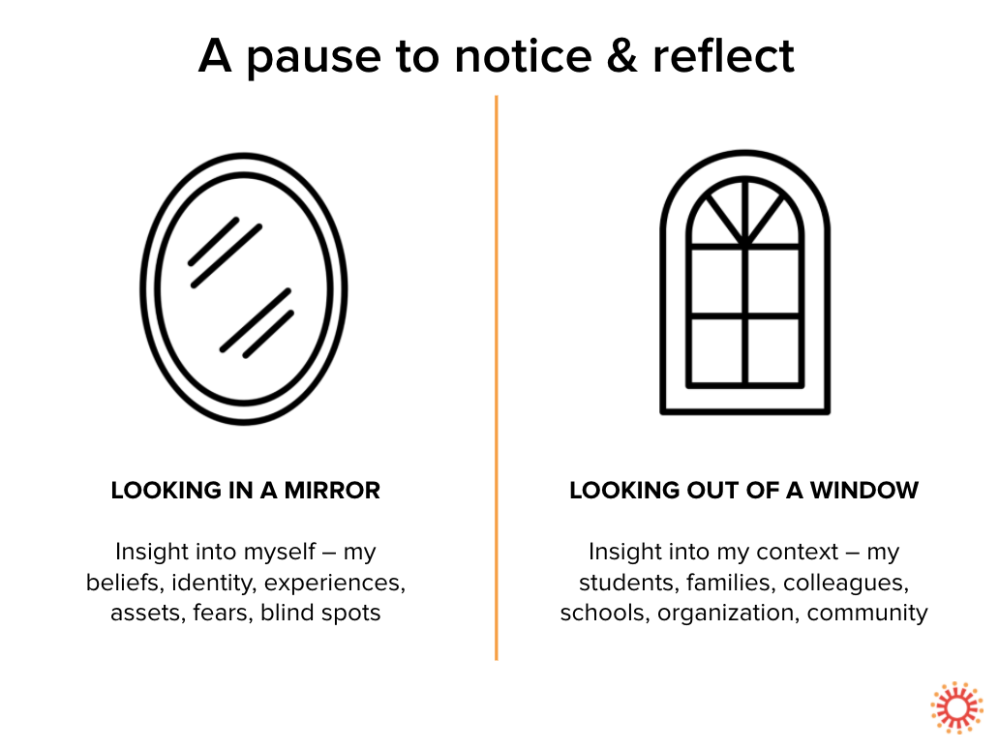
Adapted from the National Equity Project

Slide 12
ACTIVITY!
Please open up the paper you folded at the beginning so that you can draw on one of the areas on the inside of the “hamburger”
Take 2 minutes to draw your best depiction of a lion. Don’t worry about it being great or accurate, just try your best!
Feel free to share your beautiful drawing with people around you!

Slide 13
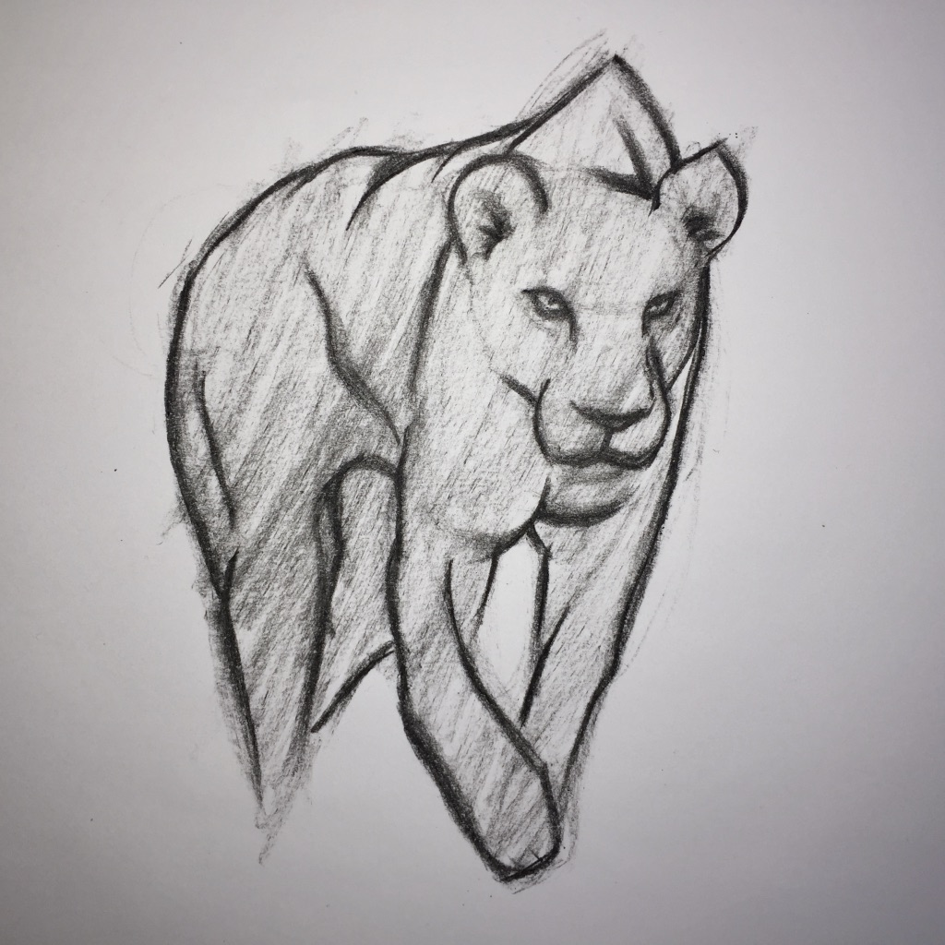
Did anyone’s lion look like this (without a mane)?

Slide 14
Blatantly obvious point time: Bias in general affects a LARGE number of ways we see and think about the world
You likely have a bias about a certain restaurant or food
You likely have a bias about the city you live in
You likely have a bias about your favorite sports team
You likely have a bias about literally everything!
Biases aren’t ALWAYS negative, but they are important to recognize! Now, these are LIGHT examples, but… (prepare for a bit of discomfort!)

Slide 15

What is Unconscious or Implicit Bias?
Unconscious or Implicit Bias
The attitudes or stereotypes that affect our understanding, actions, and decisions in an unconscious manner.
Natural/Biological
Widely prevalent and robust: everybody has it
Activated involuntarily
As educators and equity leaders, we need to be aware of the “hidden” aspects of culture at play in our schools, communities, and ourselves.

Slide 16
The Iceberg Concept of Culture
What is Unconscious or Implicit Bias?
The Iceberg Concept of Culture
Primarily in awareness
body language attire/clothing race/ethnicity words/language accent
Family status
Primarily out of awareness
Dis(ability) Religious beliefs
body language notions of leadership
work style Beliefs, Values, Feelings
nature of friendship Fears, Hopes, Motivations
Education Talents
roles in relation to status class, occupation, kinship
Life experiences Nationality
Biases, Prejudices

Slide 17
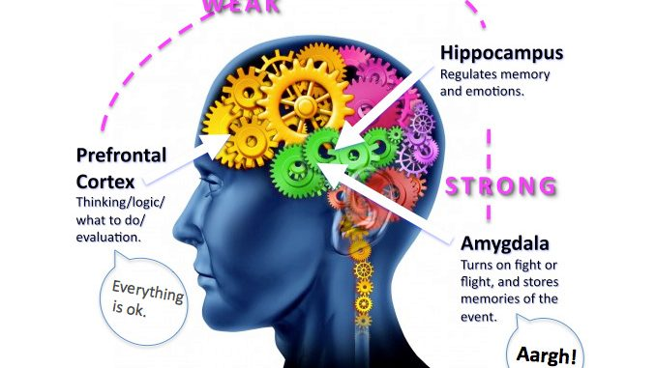
Serves an evolutionary purpose - amygdala
Propensity for brain to create patterns in order to ‘make sense’ of information
Does not necessarily align with our declared beliefs
Malleable, but can be unlearned and replaced with new mental associations and positive biases
Your Brain & Implicit Bias

Slide 18
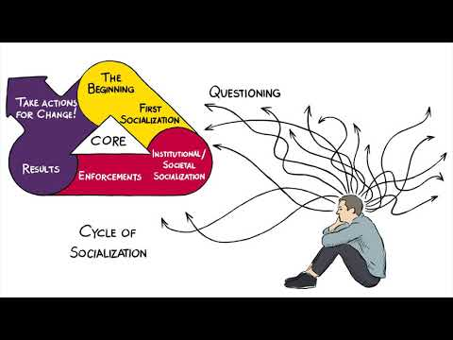
Implicit Bias Video
Source: National Education Association

Slide 19
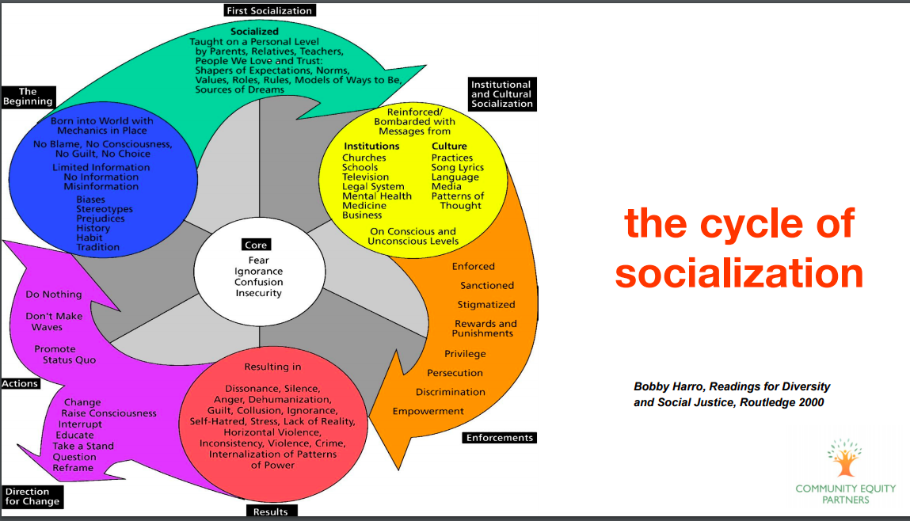

Slide 20
Take 2 minutes to reflect on which environments and perspectives in the cycle of socialization you may have been affected by.
Then, share with others which aspects you think are most powerful in shaping how people IN GENERAL think in society.

Slide 21
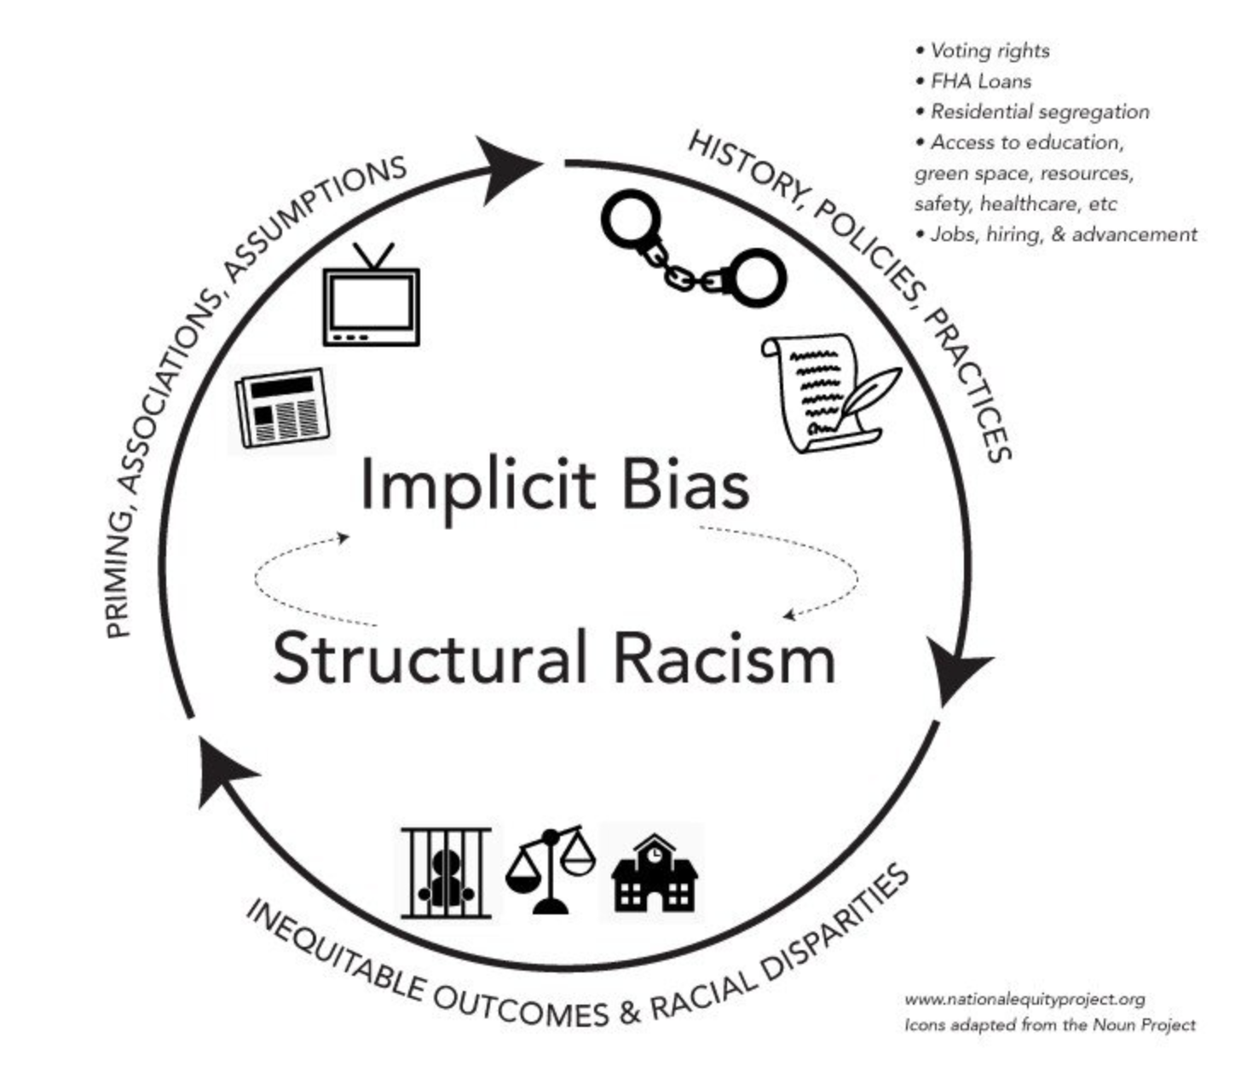
This is an insidious cycle…
  structural inequities produce inequitable outcomes which then reinforce harmful stereotypes about students of color and students living in poverty and which are then used to justify inequitable practices such as holding low expectations, academic tracking, and punitive discipline in schools.
Implicit Bias & Structural Racism

Slide 22

Noticing Bias Around Us

Slide 23
Examples of ways unconscious bias affects schools:
Classroom roles/participation
Disproportionality in discipline
Disproportionality in special education designation
Misgendering students
Grading
Dominant discourse re: “smart” “bright” “slow” “bad” students
How we view/talk about students’ families and communities
Examples in Schools
Biases may affect our ability to build relationships and empathize with our students and families, which is a cornerstone of strong teaching.

Slide 24
How can these happen if all stakeholders are, according to them, people who care and want the best for their students regardless of race, background, etc?
Examples in Schools

Slide 25
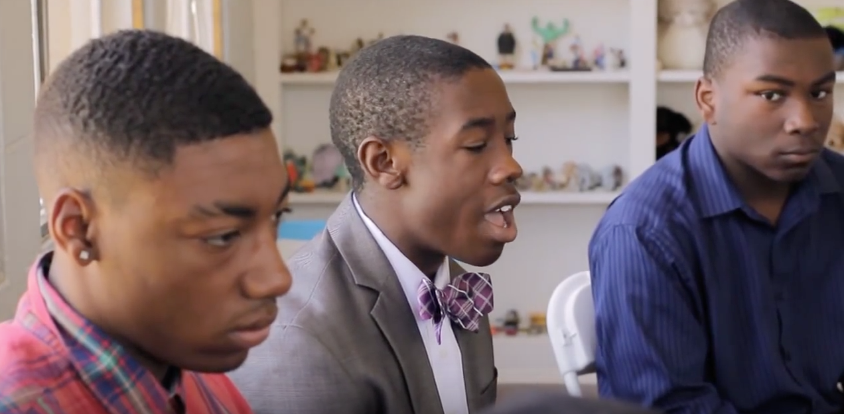
Reflection Questions:
What was surprising?
How did this make you feel?
What connections are you making from hearing the voices of students?
Hearing From Students

Slide 26
Resources to Explore
Deeper Understanding of Implicit Bias:
American Psychological Association
National Library of Medicine
Strategies and Suggestions about Combating Implicit Bias:
American Federation of Teachers, “Understanding Implicit Bias: What Educators Should Know”
American Bar Association, “Eliminating Implicit Bias: First Step, Admit You Have It”
National Center for Cultural Competence, “Six Interventions to Tackle Unconscious or Implicit Bias”
Think Cultural Health, “Combating Implicit Bias and Stereotypes”
Very Well Mind, “How Does Implicit Bias Influence Behavior?”
Maryville University, “How to Identify and Overcome Your Implicit Bias”
Additional/Supplemental Resources

Slide 27
Sooo….
What do we do to address this??
One tool for reflecting on our own Implicit Biases is the Harvard IAT

Slide 28
GWHS
The Implicit Association Test (IAT)
Monday, April 15th
Notes:
IAT test: https://implicit.harvard.edu/implicit/takeatest.html

Slide 29
The Implicit Association Test (IAT) is a test from Project Implicit, a 501(c)(3) non-profit organization and international collaborative of researchers who are interested in implicit social cognition.
Project Implicit was founded in 1998 by three scientists – Dr. Tony Greenwald (University of Washington), Dr. Mahzarin Banaji (Harvard University), and Dr. Brian Nosek (University of Virginia).
The Implicit Association Test (IAT) measures implicit attitudes that people may be unable to report. The IAT may be especially interesting if it shows that you have an implicit attitude that you didn't know about. For example, you may believe that women and men should be equally associated with science, but your automatic associations could show that you (like many others) associate men with science more than you associate women with science. It is important to know that your implicit associations are not a reflection of your deeply held beliefs of justice and equity. We will have an opportunity to debrief this process after.
What is the IAT?

Slide 30
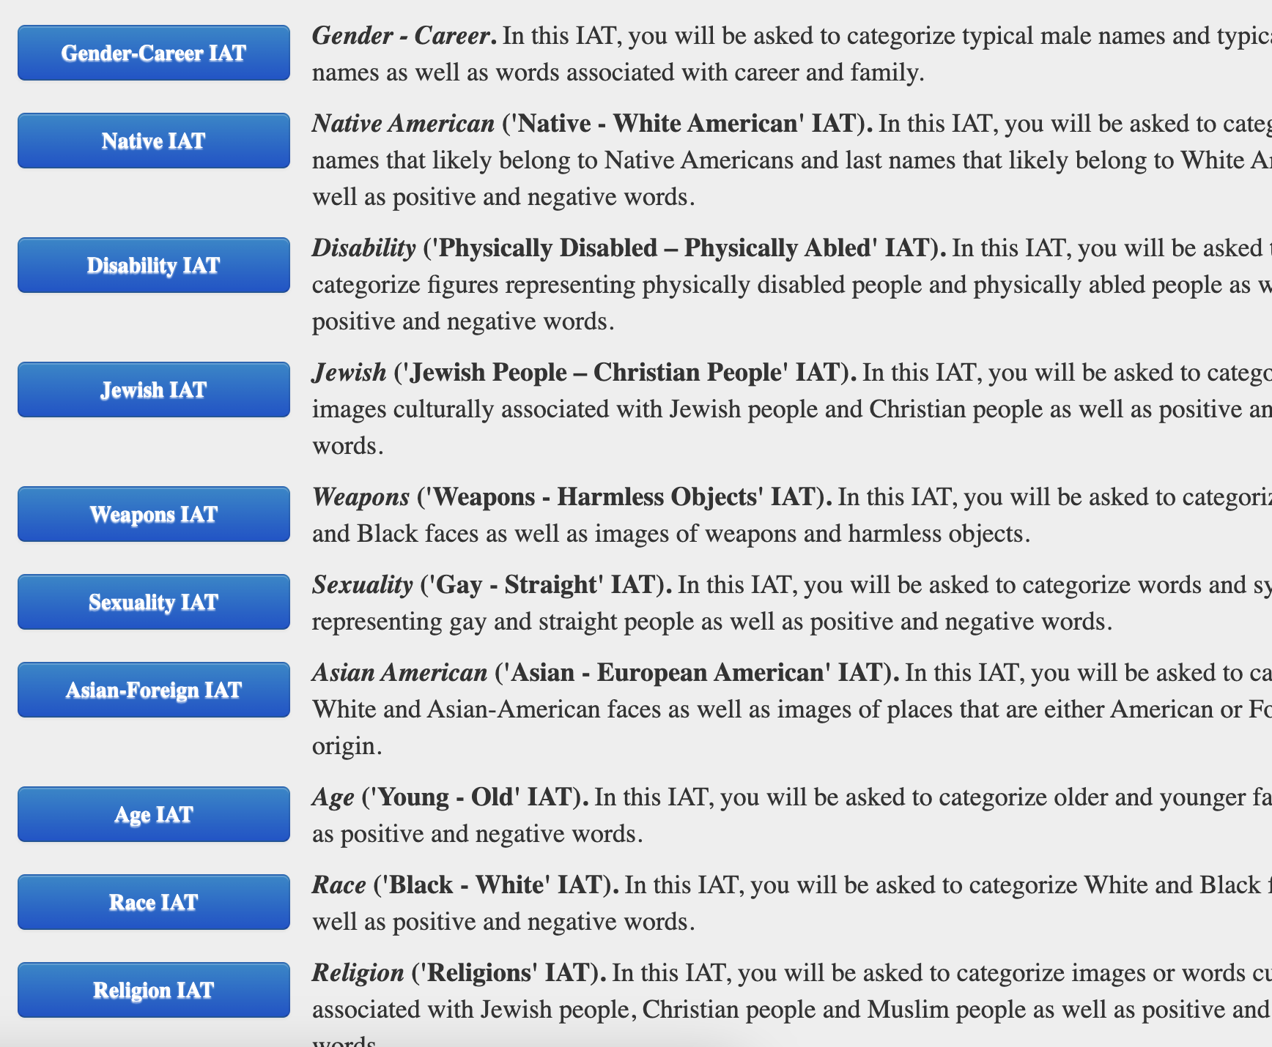
Taking the Race IAT Test

Slide 31
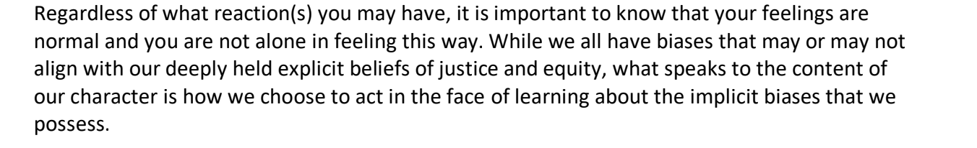
After taking the Race IAT test…
What feelings or reactions did you have upon learning your IAT results?
Reflect on your life experiences that may have influenced your results. Consider your childhood and family upbringing; the neighborhoods in which you’ve lived; media messages; your family and peer networks; etc. How might these experiences have impacted your results, with or without your conscious awareness?
What do you want to do with the results?
Debriefing the IAT

Slide 32
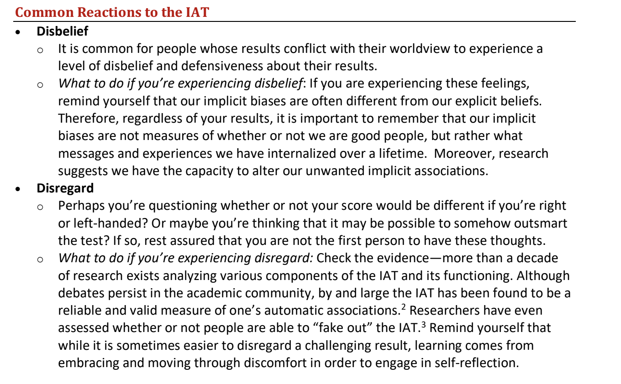
Making Sense of Your IAT Test
Notes:
https://drive.google.com/file/d/1W-8NsGusvndROx_oEixjYrm83tWzV4zD/view?usp=sharing

Slide 33
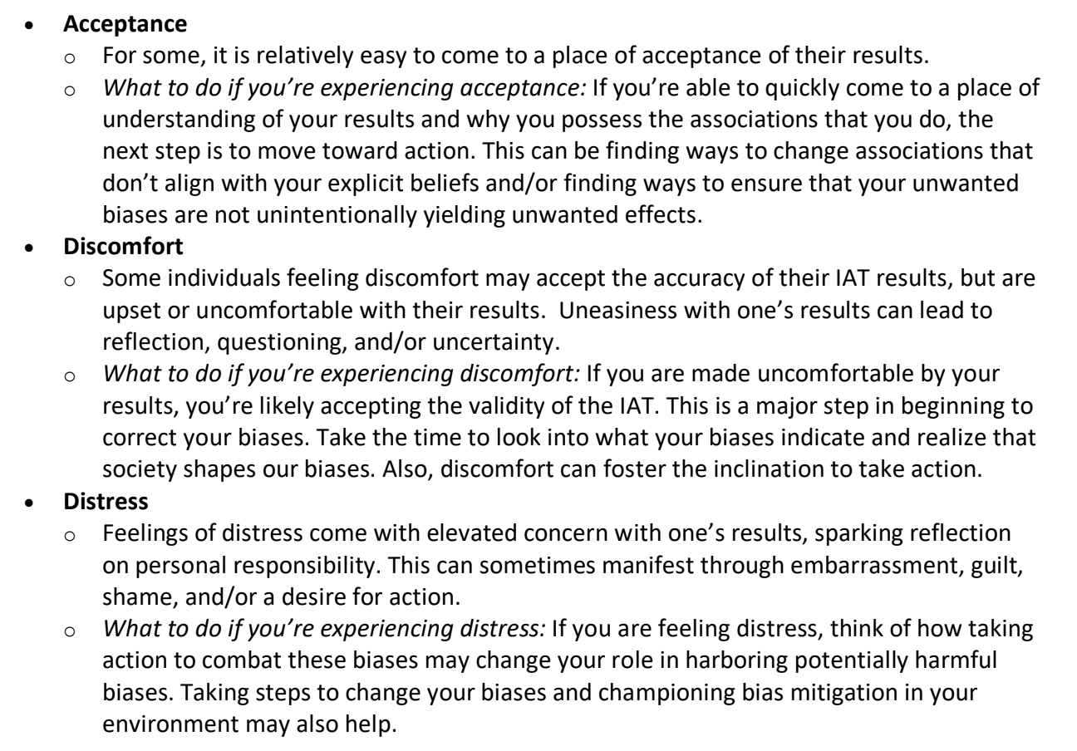
Making Sense of Your IAT Test
Notes:
https://drive.google.com/file/d/1W-8NsGusvndROx_oEixjYrm83tWzV4zD/view?usp=sharing

Slide 34
**Remember!**
The Harvard IAT is merely a tool that can be helpful in getting information and data about possible implicit tendencies we may have and may otherwise never recognize. Recognition helps us be able to challenge biases which may be problematic to our ability to connect with students fully.
It is NOT:
Diagnostic
Just because you get a certain result, does not mean that you are suddenly racist, ableist, sexist, bigoted, and/or a horrible human being. It simply offers information which can be used to reflect on what kinds of biases we may have and may need to challenge.
Invasive
All of the demographic questions in the IAT sequence are optional and only used for the purposes of providing deeper insights into the results people get (i.e. how many people who take the test that identify as a certain race/demographic get certain results). The only demographic questions which the assessment requires you to answer is your birth month and year, and even these you can lie about if you are truly uncomfortable providing that information.
From the SDP
The Harvard IAT has no connection to the School District of Philadelphia, GWHS, or anyone who is connected to you or your career. The information from your assessment does not go anywhere but to the people who designed it, who only use it as it is meant to be used: as a tool to gather insights about the state of implicit bias in America.
Making Sense of Your IAT Test

Slide 35
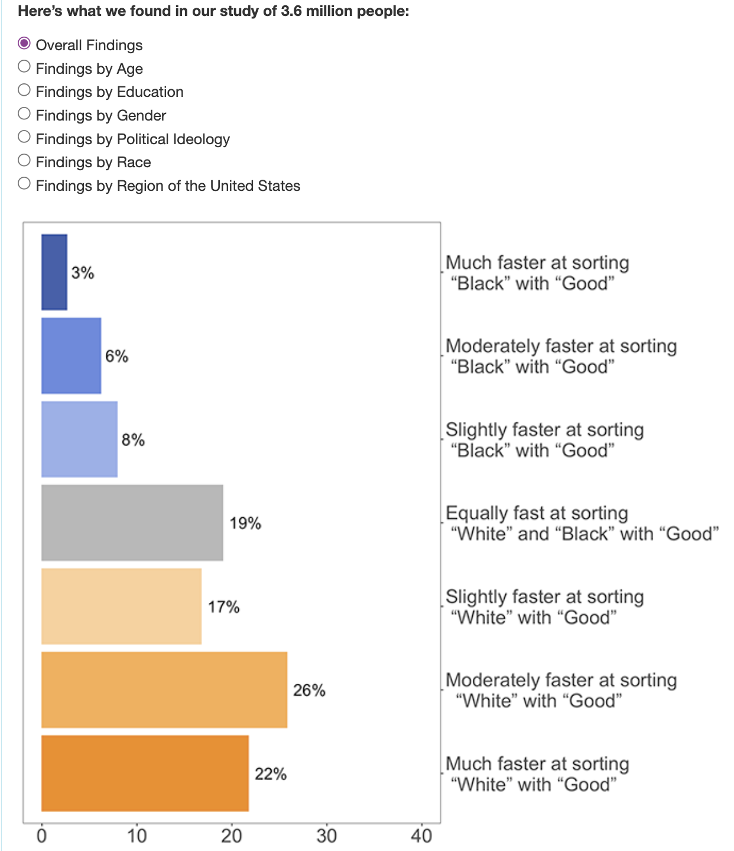
A helpful visual of the results people get to the Race IAT nationwide:
(This is also provided for you after you complete the assessment yourself)
Making Sense of Your IAT Test

Slide 36
If you have questions, concerns, or thoughts that you would like to share or get feedback on, please do not hesitate to reach out!
Making Sense of Your IAT Test

